Slide 1
The Design of Everyday Things
Unit 2
CC7 Human Computer Interaction
Arnemie B. Gayyed

Slide 2
Table of Contents
Fail Designing
Donald A. Norman Principle
Six concepts in designing

Slide 3
Fail Designing
Design is not just what it looks like and feels like.
Design is how it works
-Steve Jobs-

Slide 4
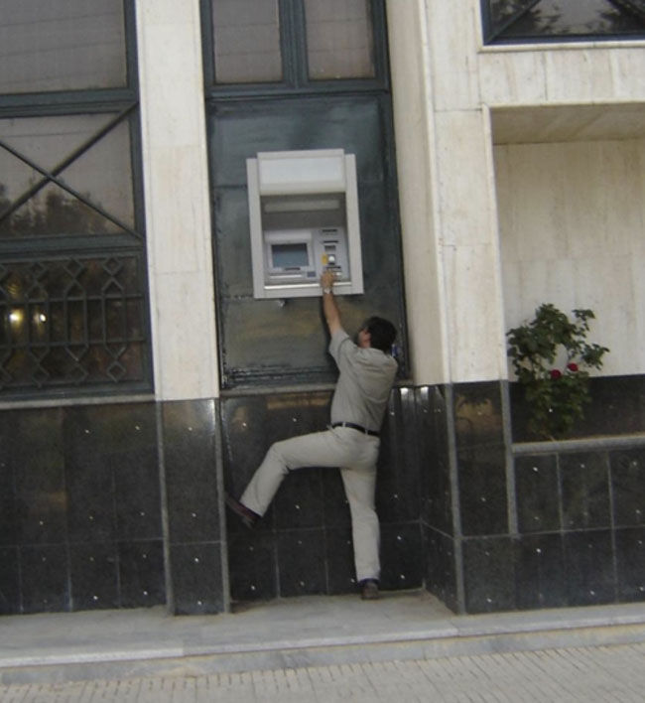
Notes:
Check out the ATM below.
You have to wonder what the designers were drinking before they let this leave the drawing board.
Perhaps, there is an abundance of giants in their neighborhood?
It’s the only reason we can think of for letting this go ahead

Slide 5
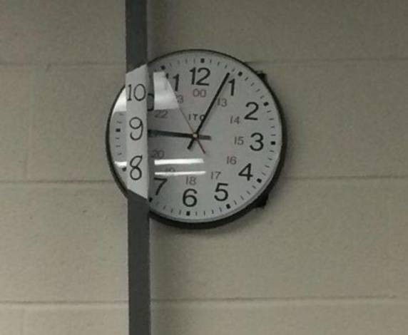
1. When you really need to examine the time in three dimension

Slide 6
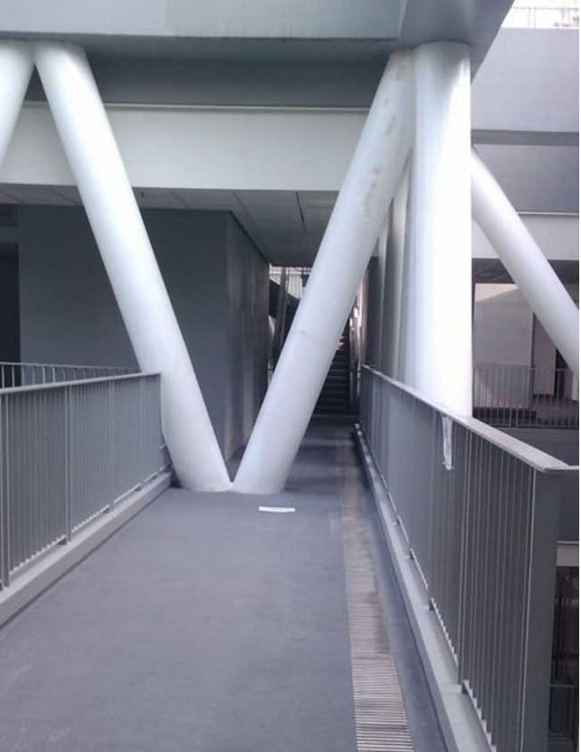
2. Thou shall not pass

Slide 7
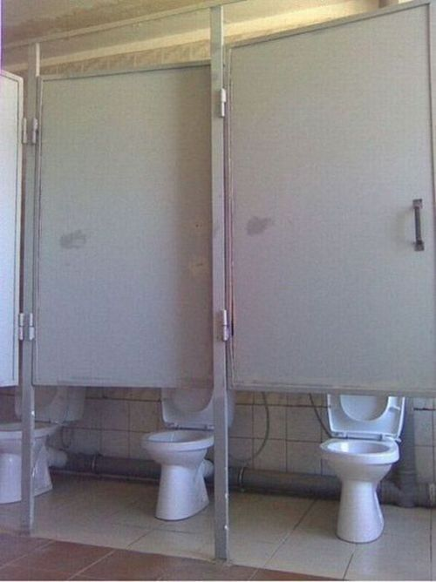
3. Social media… social toilet?

Slide 8
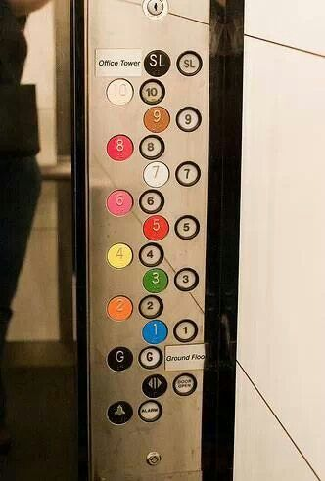
4. Its probably time to take the stairs

Slide 9
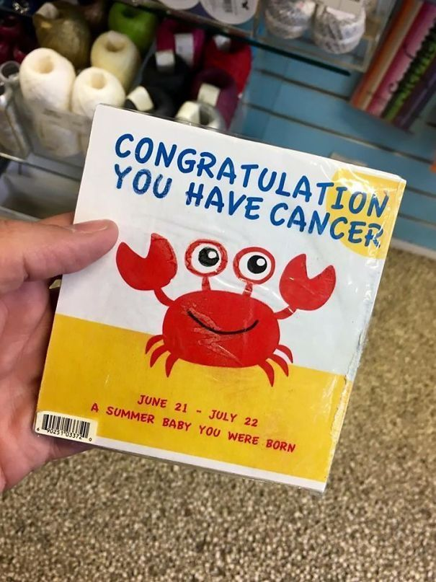
5. These people always see something positive

Slide 10
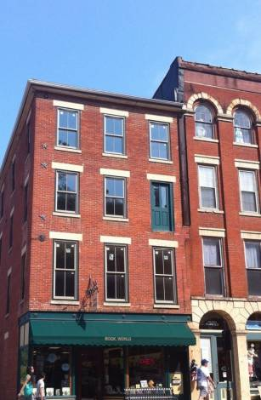
6. A door into the unknown

Slide 11
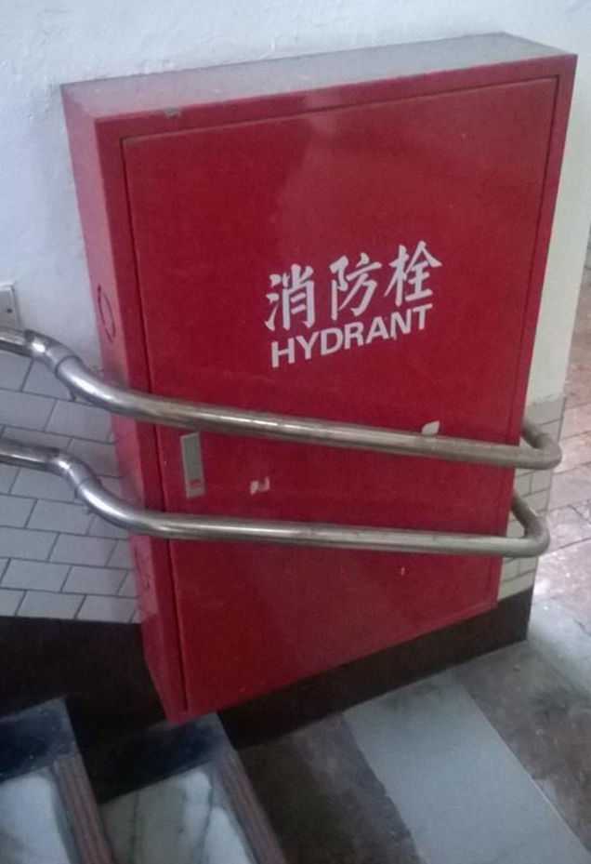
7. In case of fire, please find somewhere else to put it out

Slide 12
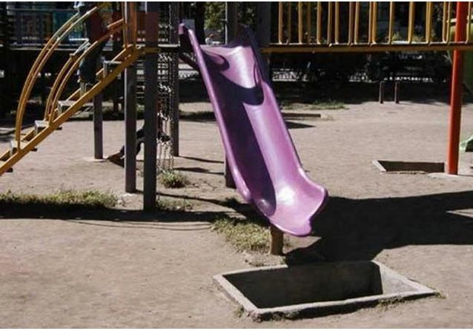
8. The serial killer playground

Slide 13
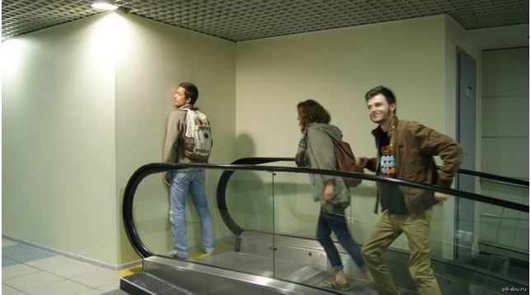
9. We’re on the escalator to nowhere, come on and bump.

Slide 14
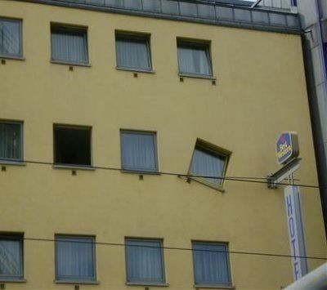
10. Architectural masterpiece

Slide 15
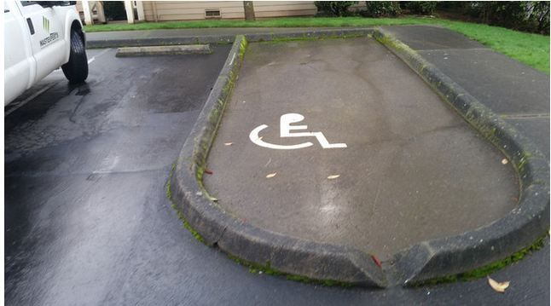
11. All you need now is an all-terrain wheelchair

Slide 16

12. See no evil

Slide 17

13. Will it be fried eggs or a trip to hospital tonight?

Slide 18
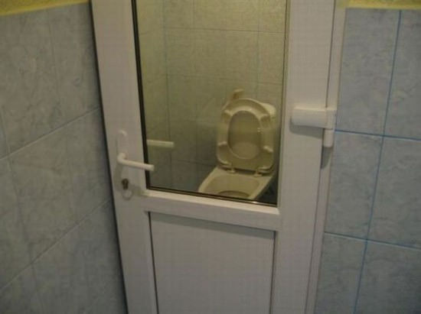
14. Big brother is watching you

Slide 19
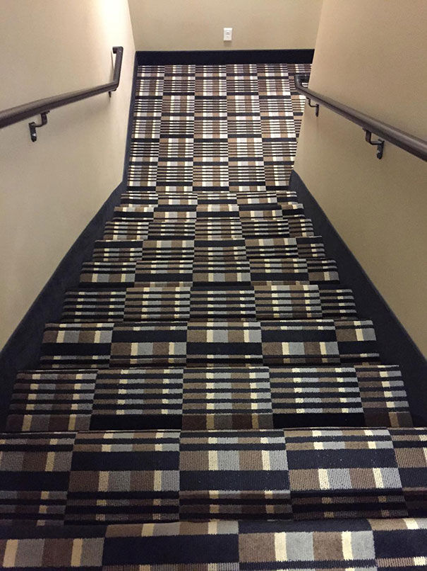
15. All they say pride goes before a fall

Slide 20
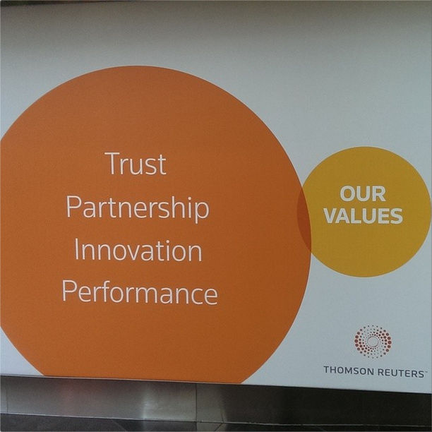
16. Venn Diagram

Slide 21
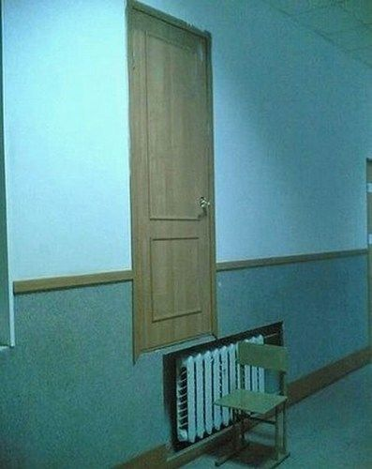
17. Take a step into the unknown

Slide 22
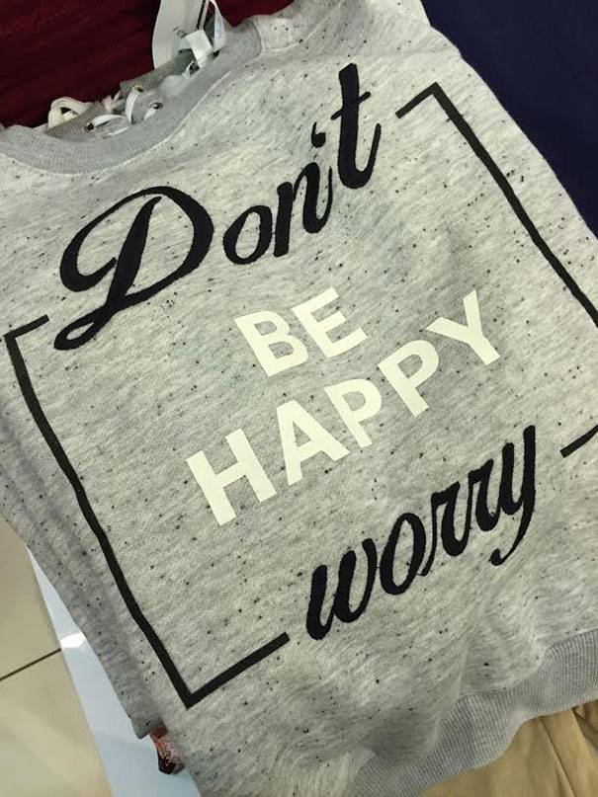
18. We know few parents who might adopt this slogan

Slide 23

19. Kevin from Home Alone

Slide 24
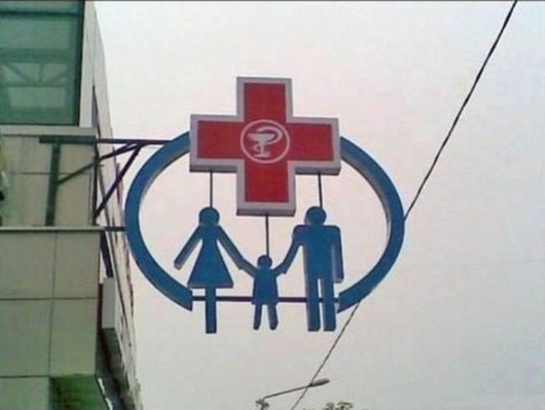
20. The Family that should have bought better life insurance?

Slide 25
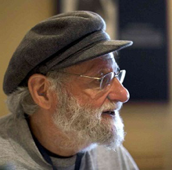
Donald A. Norman
University professor, industry executive, company advisor, and board member;
Electrical engineer, psychologist, computer scientist, cognitive scientist, designer;
Speaker and author
Founder and Director of the Design Lab at the University of California, San Diego

Slide 26
Design for real people
“We must design for people the way they are, not the way we wish them to be.
Also, don’t be logical. Half the people in the world are below average”
-Donald A. Norman-

Slide 27
Donald A. Norman Principle
Notes:
Norman's main idea is that devices, things, computers, and interfaces should be functional, easy to use, and intuitive.
His idea is that there are two gulfs to avoid: the gulf of execution and the gulf of evaluation.

Slide 28
Gulf of Execution
Is the difference between the intentions of the users and what the system allows them to do or how well the system supports those actions.
In order to design the best interfaces, the gulf must be kept as small as possible

Slide 29
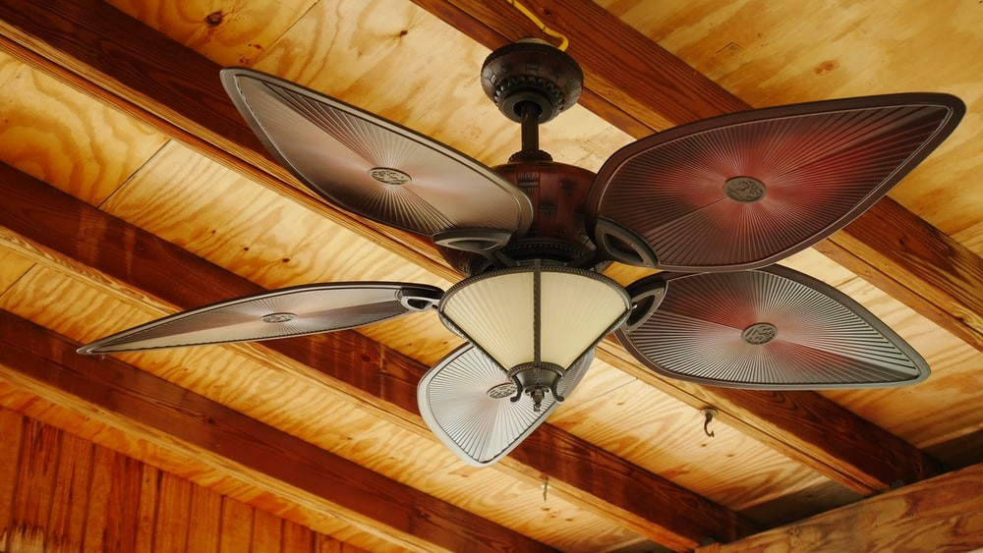

Example
Notes:
You switch on the fan and you see whether fan is running or not. If you can find out immediately, that means the gulf of execution is small or negligible.
On the other hand, you turn on the heater, it takes a few mins before you can find out whether it is heating or not. This means that gulf of execution in this case is higher.

Slide 30
Gulf of evaluation
is the degree of ease with which a user can perceive and interpret whether or not the action they performed was successful.
the gap in finding out what is the current state of the system.
Notes:
Evaluation means to assess or evaluate something – to find out what is its current state.

Slide 31

Example
Notes:
You look at the fan and you can immediately tell that either the fan is on or off. Hence gulf of evaluation in this case is small.
you click on a link on a website. On doing that, it shows a page stating "Loading...." This doesn't give clarity on what’s happening – is the website going to load, will it not load, what is the current state of launching the website. You cannot determine how much time you have to wait before you can find out if the page is loaded or not. In this case the gulf of evaluation is high.
Another example, you are talking to your friend. He has recently gone through a setback and you have met him right after that. He is talking to you normally. You know he must not be right but you cannot find out what exactly is his state of mind. This is a huge gulf of evaluation. You can’t figure out what your friend is going through. Is he fine, is he not? Should you be worried?

Slide 32
How do we avoid the twin gulf?

Slide 33
Six Principles of Design
Visibility
Feedback
Affordance
Mapping
Constraints
Consistency

Slide 34
1. Visibility
Users should know, just by looking at an interface, what their options are and how to access them
2. Feedback
Users should know, just by looking at an interface, what their options are and how to access them
Notes:
VISIBILITY
This is particularly important in mobile applications because it is a challenge to make everything visible within the limited screen space; hence, it is essential to include only the options that are needed. For example, a log-in screen only needs information about logging in or signing up, so cluttering it with other information would go against the visibility principle.
FEEDBACK
Google Chrome does a great job of this when they're loading pages. The little spinning circle starts as soon as you hit enter, so you know something's happening, and goes faster when the page is about to load, so you know you're about to do something again. It’s simple and effective feedback.

Slide 35
3. Affordance
is the link between how things look and how they’re used. For example, a coffee mug has high affordance because you instantly know how to hold it just by looking at it
4. Mapping
Mapping is the relationship between control and effect. The idea is that with good design, the controls to something will closely resemble what they affect.
Notes:
AFFORDANCE
For designers, it means that as soon as someone sees something, they have to know how to use it. For example, a mug has high affordance: it's easy to figure out intuitively how to use it. For web designers, affordance is even more important. Users need to be able to tell how to access information they want from a website, or else they’ll just leave.
MAPPING
A great example of mapping is the vertical scroll bar. It tells you where you are in a page, and as you drag it down, the page moves down at the same rate; control and effect are closely mapped.

Slide 36
5. Constraints
restrict a particular form of user interaction with an interface
6. Consistency
The same action has to cause the same reaction, every time.
Notes:
CONSTRAINTS
An example of a constraint is an online form that does not allow users to enter letters into a phone number field.
CONSISTENCY
For example, if a website’s buttons are protruding boxes with labels on them, then all of the website’s buttons should look like that. Similarly, if a backward arrow denotes the back button, then it​ should not be changed to something else because that would be inconsistent with what the user has learned.

Slide 37
Sources
https://www.educative.io/answers/gulf-of-execution-and-gulf-of-evaluation
https://www.linkedin.com/pulse/gulf-execution-vs-evaluation-nidhi-kohli-pmp-pmi-acp-sfc-itilv3/
https://www.enginess.io/insights/6-principles-design-la-donald-norman
https://www.educative.io/answers/what-are-normans-design-principles
https://www.enginess.io/insights/6-principles-design-la-donald-norman

